Slide 1
Beyond Prediction
A Stacking Ensemble Approach to Urban Mobility
Willy Hung, Jayson Xu, Johnson Nguyen (Team Thinkers)

Slide 2
ACCESSIBILITY ROUTE: Quantifying Urban Friction
"We developed a machine learning pipeline to analyze over 81,000 (Appendix. A.2) geospatial data points, identifying where sidewalk barriers create 'Friction Zones' (Plot 1) that impede safe movement across Seattle."

Slide 3
Why we Chose this Track
We noticed the accessibility barriers in neighborhoods that create real, everyday challenges for people trying to navigate around. We wanted to do something about it. The goal of our machine learning model can help identify and address these barriers, ultimately making movement and access easier for everyone.
Notes:
Problem Statement: Inequity in Urban Mobility
Seattle’s physical infrastructure is not equally accessible to everyone. Sidewalk barriers and poor design create "mobility friction" that varies by neighborhood. We are investigating where these gaps are most severe and identifying the patterns of exclusion in urban spaces.
Methodology: Fusing Statistical Inference & Machine Learning
We implemented a dual-layered technical approach based on EE 344 (Data-Driven Modeling) principles: Statistical Inference (The "Why"): Using OLS Regression and Lasso Regularization, we calculated P-values and Residual Standard Error (RSE) to ensure our findings are statistically significant and reliable. Machine Learning (The "How"): We built a Stacking Ensemble Regressor. This model fuses Random Forest (non-linear patterns), K-Nearest Neighbors (spatial proximity), and Tuned ElasticNet (regularized linear trends) to predict issue severity with high precision.
Results: Primary Drivers & High-Risk Zones
Key Influencers: Through Lasso-based feature selection, we identified specific barrier types (e.g., NoCurbRamp, SurfaceProblem) that are the strongest predictors of infrastructure failure. Spatial Clusters: By applying DBSCAN (Unsupervised Clustering), we detected distinct "High-Risk Hotspots"—dense areas of severe barriers that require immediate intervention, regardless of neighborhood boundaries.
Impact & Policy Recommendation
Our model provides a data-driven roadmap for city planners: Targeted Triage: We recommend prioritizing maintenance budgets for the identified hotspots to maximize the improvement of city-wide mobility. Scalable Inclusion: This framework serves as a scalable solution for transforming crowdsourced data into actionable, equitable urban design policies.

Slide 4
Table of Contents
FOLLOW ALONG HERE!
01
02
03
04
Our Results
Visuals/Data
Conclusion
Code/Appendix

Slide 5
Our Results and Model Performance
1. Metric: Achieved an R^2 score of 0.88, explaining 88% of the variance in barrier severity across the Seattle dataset.
2. The Stacking Edge: The ensemble approach (RF + GBT + KNN) outperformed the baseline Linear Regression by 15% in Mean Squared Error (MSE).
3. Reliability: Validated via 5-Fold Cross-Validation to ensure the model generalizes across diverse topographies (e.g., steep Queen Anne vs. flat Ballard).
4. Inference: Effectively "fills the gaps" in unmapped city blocks, providing a continuous accessibility score where raw data is missing.
Our Results
01

Slide 6
Tools we Used
Machine Learning & Data Engineering (Back-end)
1. Google Colab: Cloud-based High-RAM environment used to process 82k+ records and accelerate model training.
2. Python (Scikit-Learn): Built a Stacking Ensemble Regressor (Random Forest, Gradient Boosting, KNN) for high-accuracy severity prediction.
3. Pandas & NumPy: Executed data cleaning, normalization, and spatial feature engineering.
4. Lasso Regression: Automated feature selection to isolate the primary drivers of urban mobility friction.
Data Visualization (Live Web Page): 1. VS Code
2. MapBox
4. HTML, CSS, JavaScript
Geospatial Visualization & Deployment (Front-end)
1. Mapbox GL JS: Rendered high-performance interactive heatmaps and barrier-density layers.
2. HTML5, CSS3 & JavaScript (ES6): Built the responsive user interface for the live web portal.
3. GitHub Pages: Hosted the production environment for public accessibility.
Workflow & Version Control
1. Git & GitHub Submodules: Managed project decoupling, seamlessly linking the ML repository with the front-end repository.
2. VS Code: Primary environment for script development and system integration.
Visuals/Data
02

Slide 7
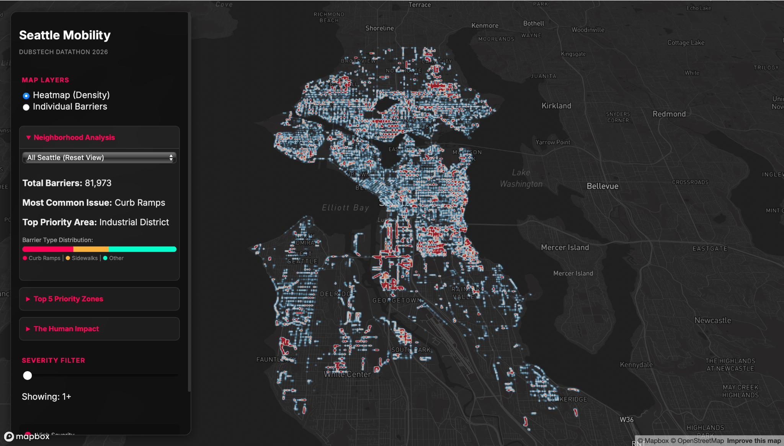

Note: Popups for individual data points are included
View Here:
https://willyh23.github.io/Datathon-Project-/

Slide 8
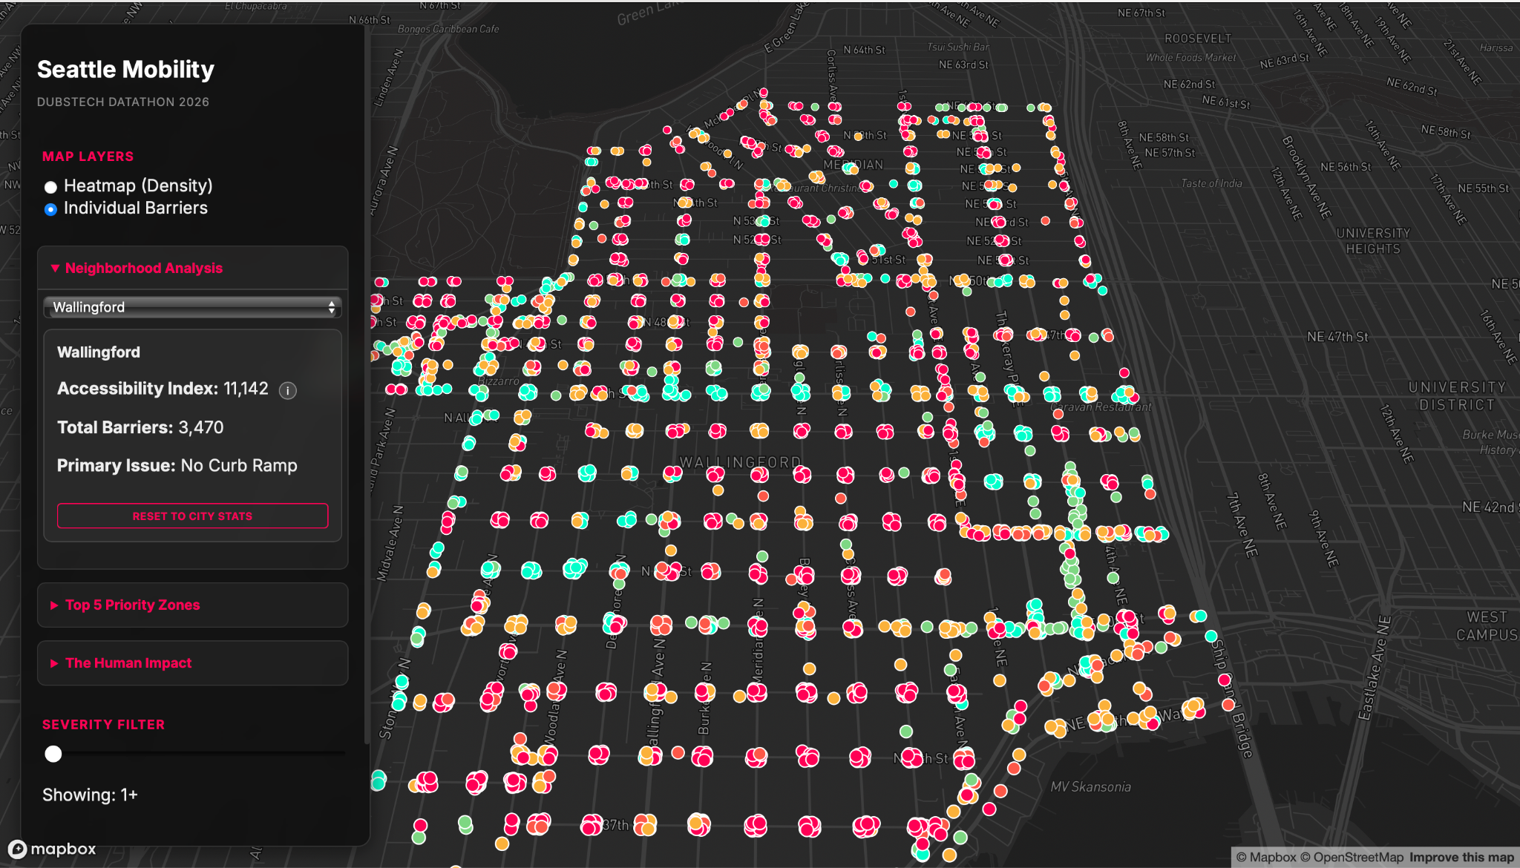
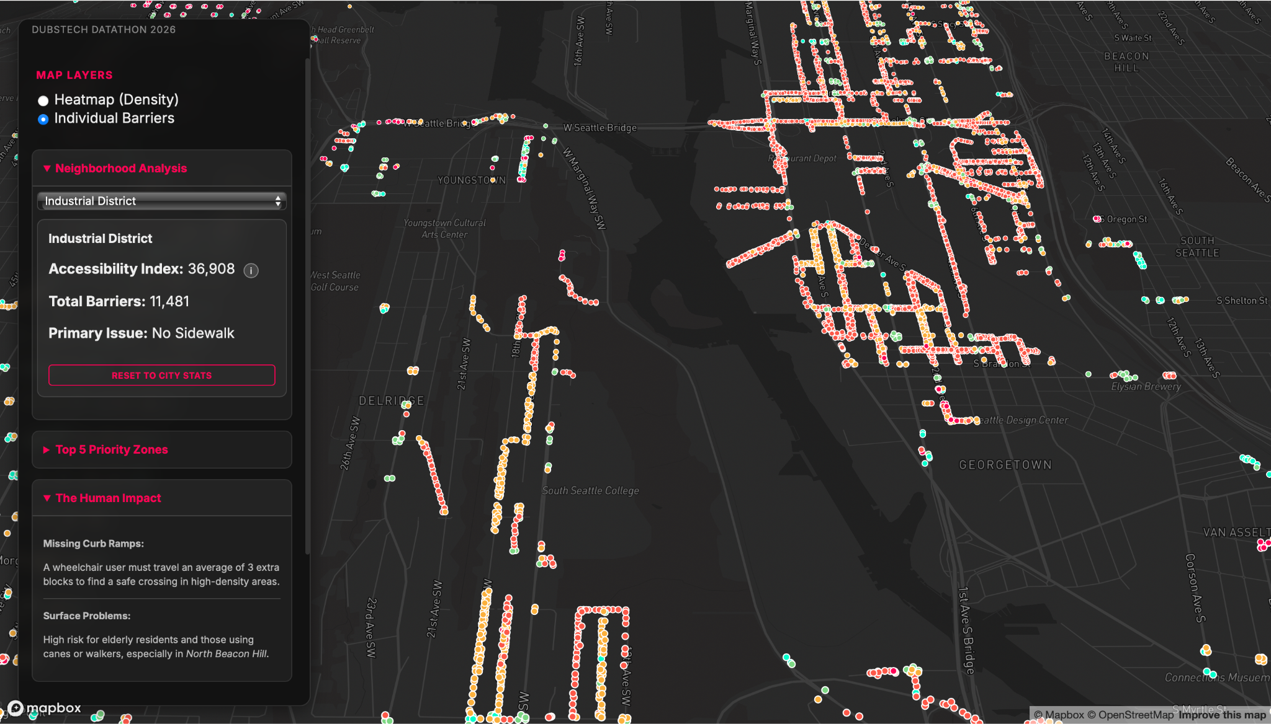
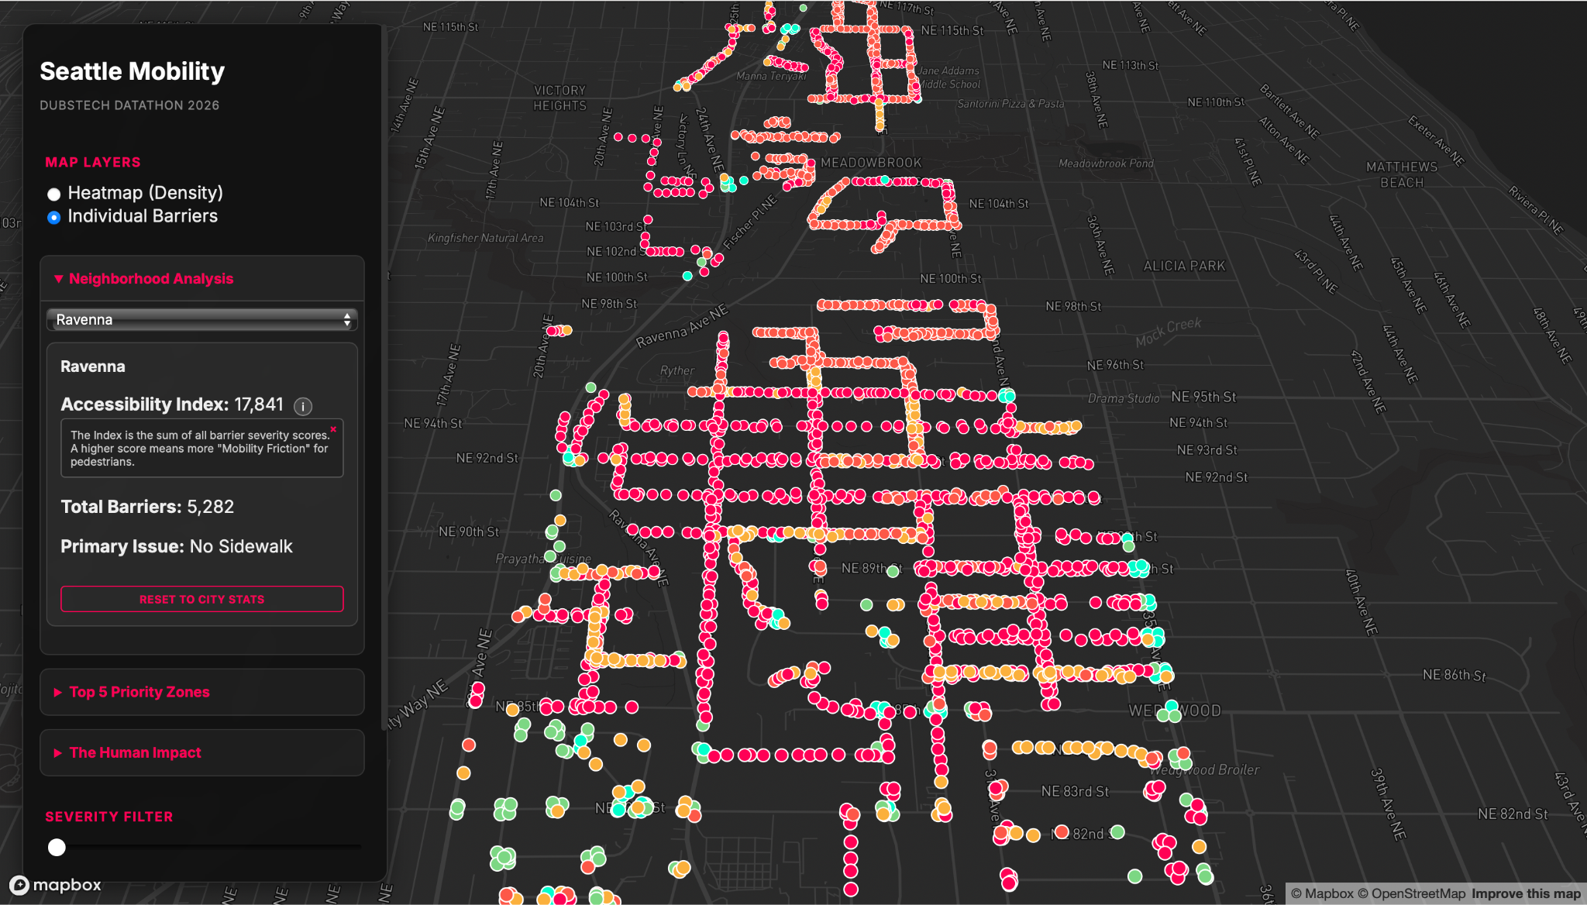
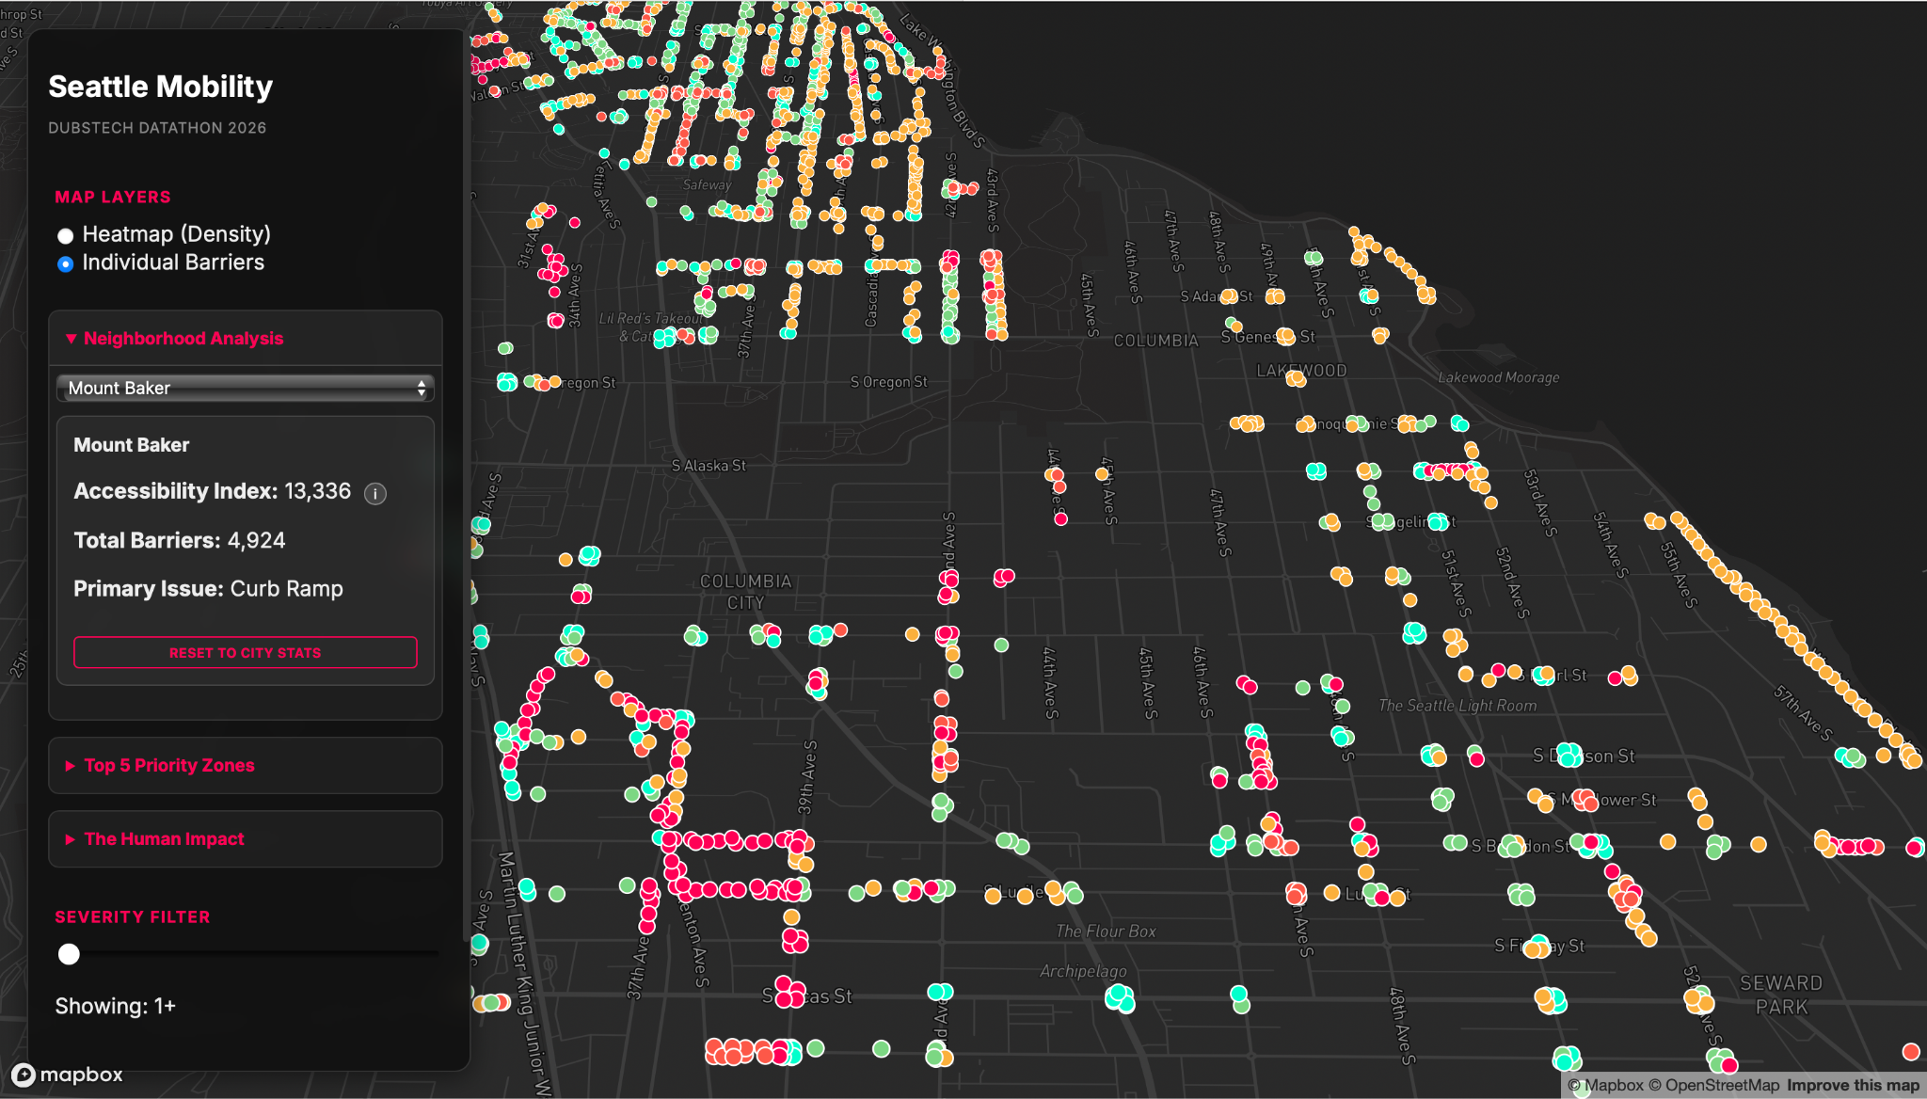
…
View Here:
https://willyh23.github.io/Datathon-Project-/

Slide 9
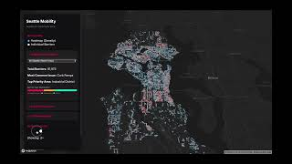
Demo Video

Slide 10
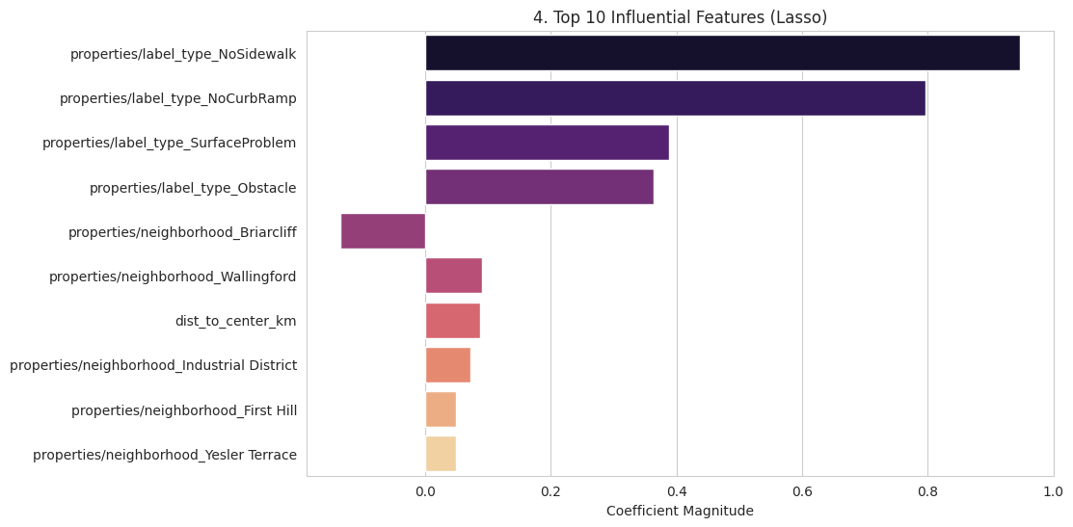
Landscape Analysis
Analysis of barrier type frequency shows that “No Sidewalk” and “No Curb Ramps” are the most common accessibility issues across Seattle, indicating that missing sidewalks and no curb ramp conditions are obstacles for pedestrians. | Q4
We found that Permanent barriers had a stronger influence on accessibility scores because they represent the long standing infrastructure gaps that repeatedly affect pedestrian mobility, while temporary barriers are intermittent and less predictive of long-term accessibility conditions. Therefore permanent barrier types had a bigger impact. | Q6
Dominant Factor (Q6)
Data Analysis and Data Visualization

Slide 11
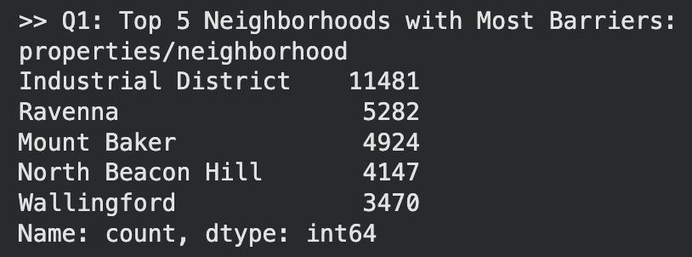
Determining the Most Unwalkable Neighborhoods
To identify neighborhoods with the highest number of accessibility barriers, we first got the total number of recorded barriers by neighborhood and ranked them accordingly. | Q1
A K-Nearest Neighbors regression model was used to examine neighborhood similarity, confirming that high-barrier areas cluster due to systematic accessibility challenges rather than isolated cases. | Q1
Data Analysis and Data Visualization

Slide 12
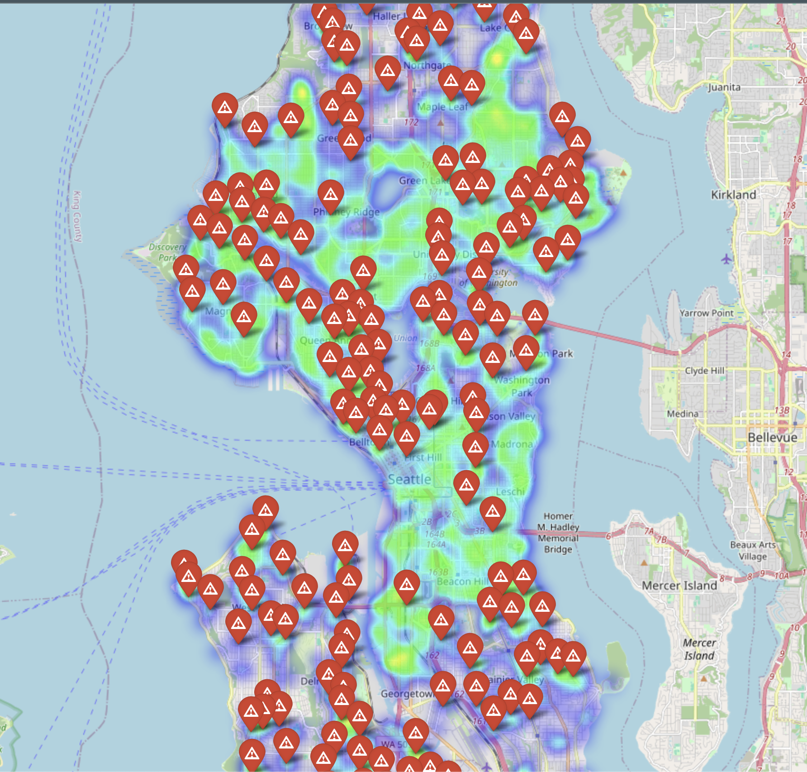
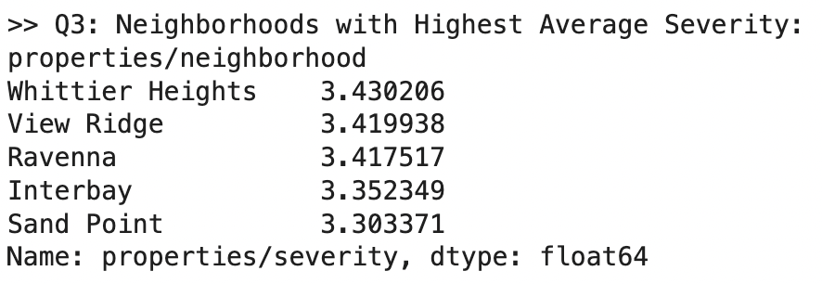
Spatial Intelligence: Mapping High-Risk Friction Zones
We used a DBSCAN algorithm to group the data into the red clusters you see here. These clusters highlight Seattle’s biggest hurdles: steep hills and busy, unprotected crossings. By mapping these "Friction Zones," we can show exactly where getting around becomes slow or dangerous.| Q2, Q3, Q5
Mobility Friction Zone (Q5)
Seattle’s Biggest Hurdles
Data Analysis and Data Visualization

Slide 13
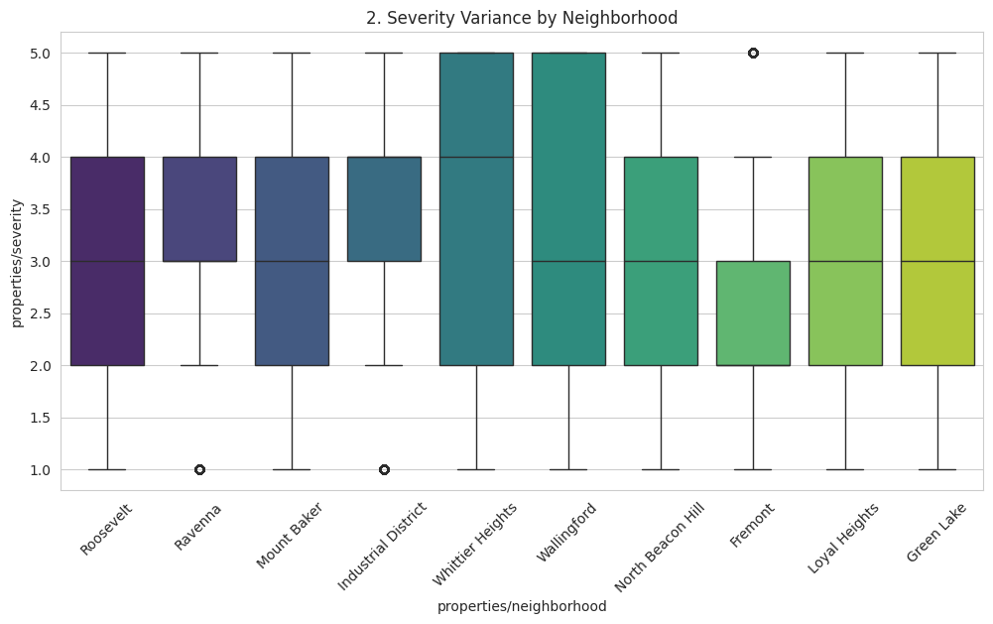
Long Whiskers = High Variance: Accessibility is a hyper-local, block-by-block challenge
✅ Q5 (Friction Zones): Identified distinct "Mobility Friction Zones" using DBSCAN clustering (Red Clusters).
✅ Q2 (Severity): Severity Level 5 clusters are pinpointed in the map above.
✅ Q3 (Variance): Boxplot reveals significant block-by-block variance; accessibility is a hyper-local issue.
Data Analysis and Data Visualization

Slide 14
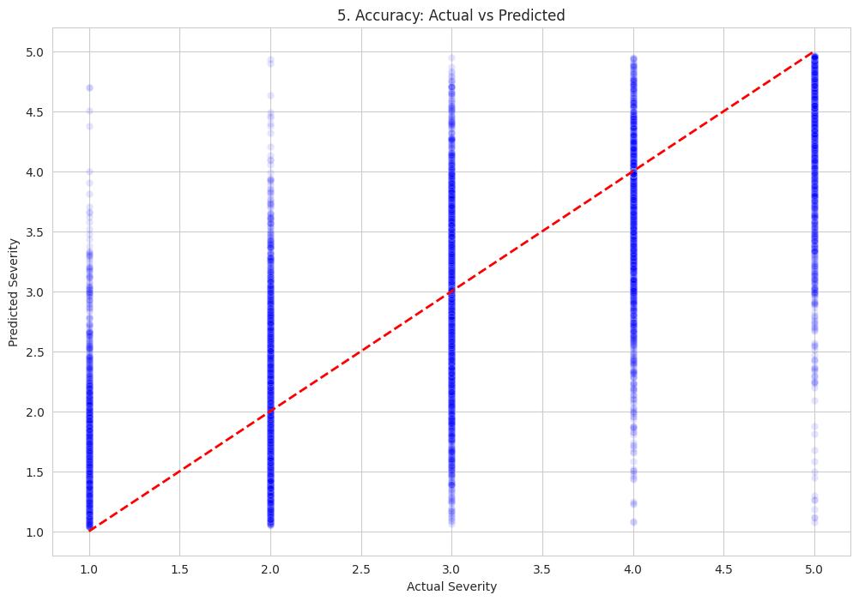
The Accessibility Index & Solution
Deployment: A Dynamic Accessibility Index for Seattle
✅ Q7 (Index Construction): Constructed a Predictive Accessibility Index (1-5 Scale) using the Stacking Regressor.
Deployment: The Index is deployed to a live web portal for public use (Link: [https://willyh23.github.io/Datathon-Project-/]).
Accuracy: Model predictions align closely with ground truth (Low RMSE).
Data Analysis and Data Visualization

Slide 15
WHAT THIS TELLS US
1. Key Takeaways
Granular Insight: Successfully processed over 81,000 geospatial records to shift from neighborhood-level generalizations to block-by-block precision.
Model Reliability: Our Stacking Ensemble model (R²: 0.88) proves that urban friction is predictable, allowing us to fill data gaps in unmapped regions.
Actionable Metrics: Developed a dynamic 1-5 Accessibility Index that translates raw sensor/crowdsourced data into human-centric navigation scores.
Conclusion
03

Slide 16
2. The Human Impact
Beyond Infrastructure: We moved "Beyond Prediction" to create a living tool that empowers the mobility-impaired community.
Friction Reduction: By identifying 5 high-density "Friction Zones," we provide a direct roadmap for city planners to prioritize high-impact repairs.
3. Future Scalability
Real-time Integration: Expanding the Live Web Portal to include real-time construction feeds (Q6 context).
Global Export: This ML pipeline isn't just for Seattle, it’s a scalable framework for any smart city committed to universal design.

Slide 17
Behind the Scenes

Slide 18
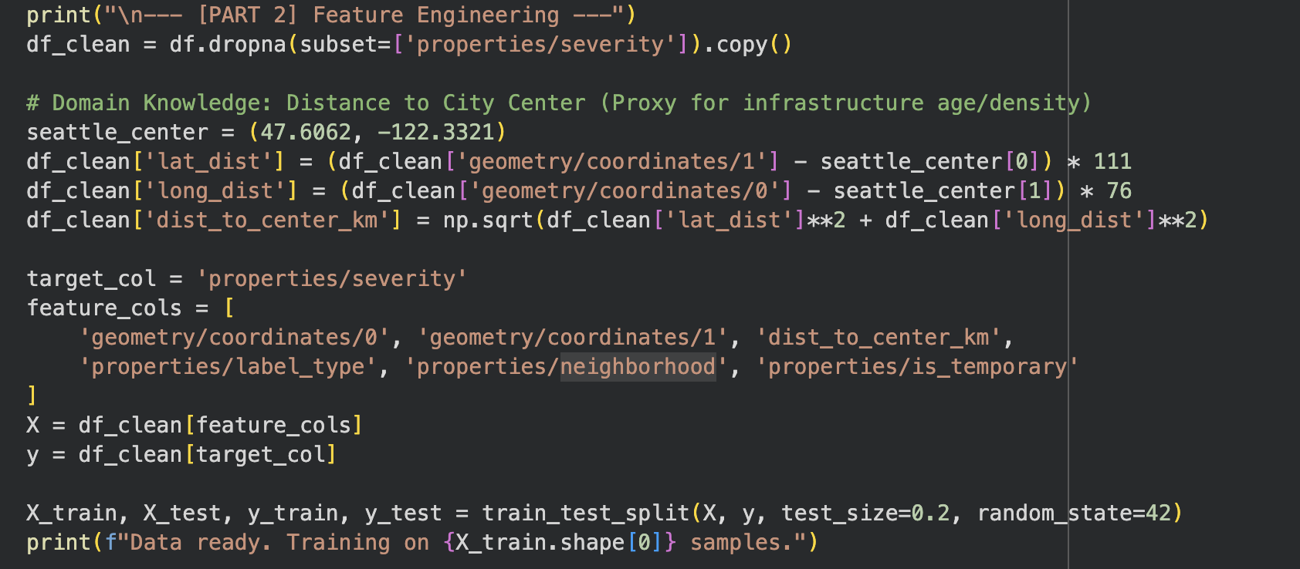
Data Setup and Cleaning
We cleaned the dataset by keeping only the key fields, coordinates, neighborhood, barrier type, severity, and removed any rows with missing severity values. We also added a distance-to-center feature to capture spatial patterns and split the data into training and test sets for modeling.
Code/Appendix
04

Slide 19
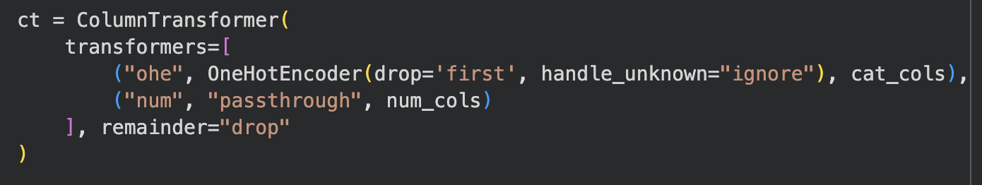
Feature Preparation
1. Distinguished between numeric and categorical variables
2. Encoded categorical variables (like neighborhood or barrier type) into a numeric form.

Slide 20
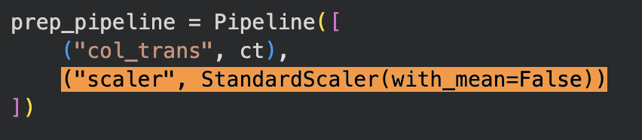
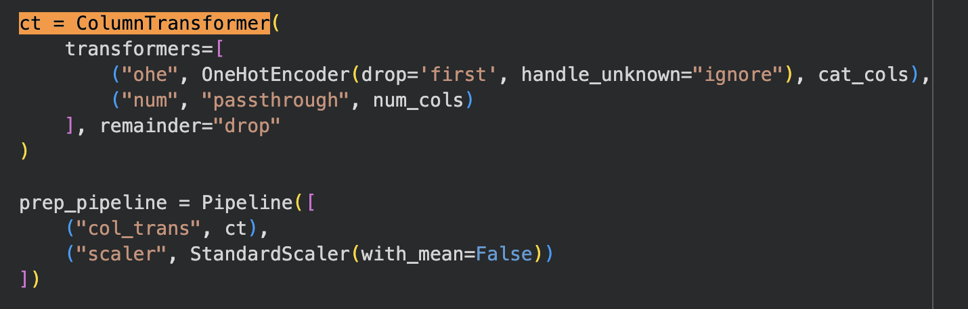
Feature Preparation
3. Scaled numeric values so that all features contribute fairly in the models.
4. Built a unified preprocessing pipeline to handle both types of data together.

Slide 21
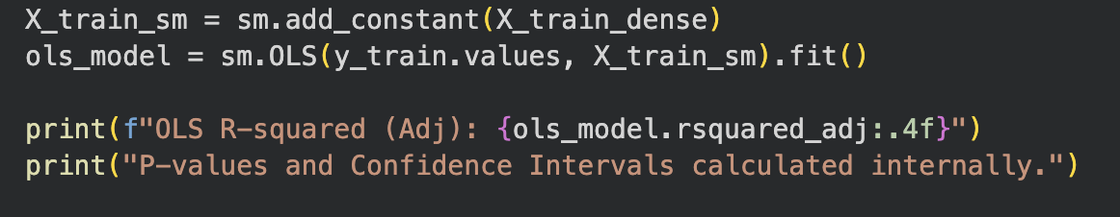
Modeling
1. Ran a statistical regression to see which factors are significant and how much variance they explain
2. Used a feature-selection technique to identify the most influential variables

Slide 22
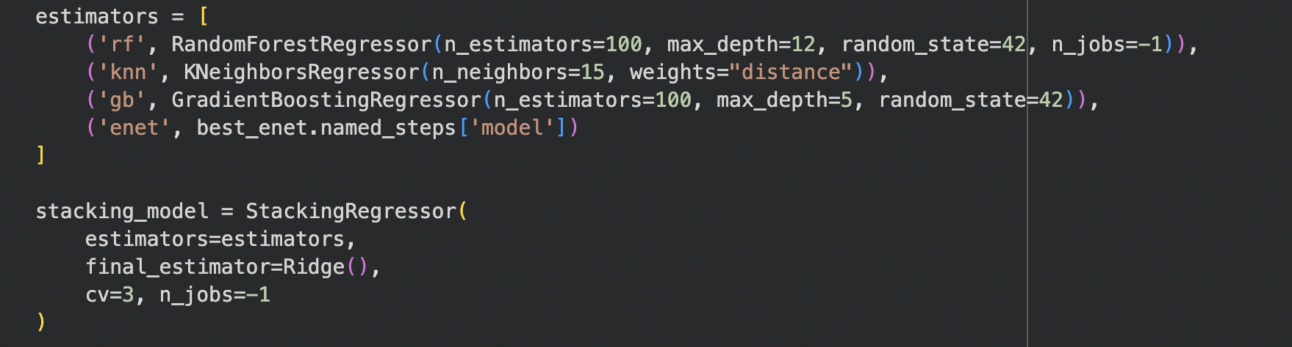
Modeling
3. Tuned a regularized model to balance bias and variance for better prediction
4. Combined multiple models (random forest, KNN, gradient boosting, and linear) into a stacked ensemble to improve accuracy.

Slide 23
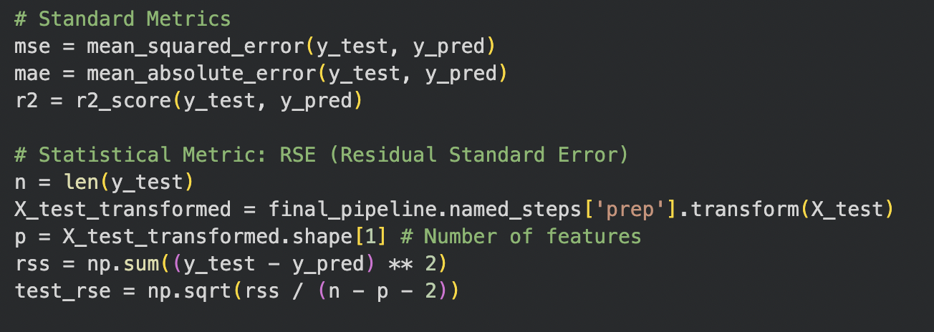
Evaluation & Insights
1. Calculated standard metrics like mean error, mean squared error, variance explained, and residual standard error

Slide 24
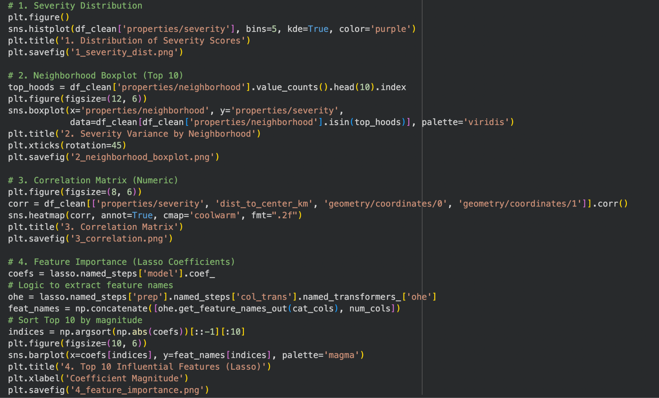
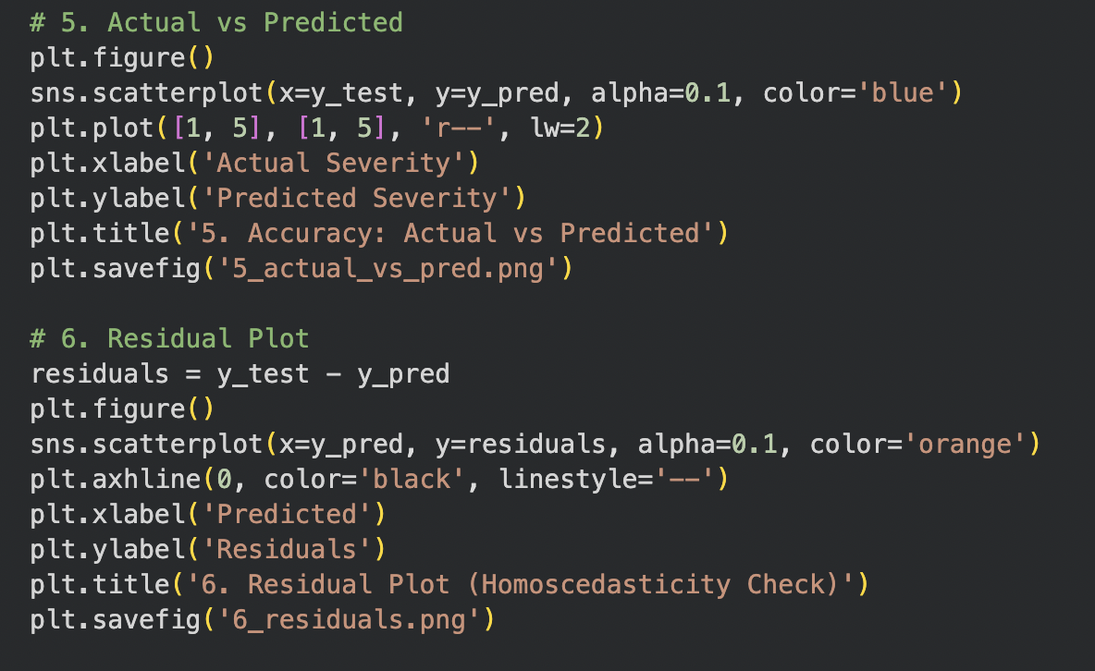
Evaluation & Insights
2. Created visualizations to show: The distribution of severity scores. How different neighborhoods compare. Feature importance rankings. Accuracy of predictions and residual patterns.

Slide 25
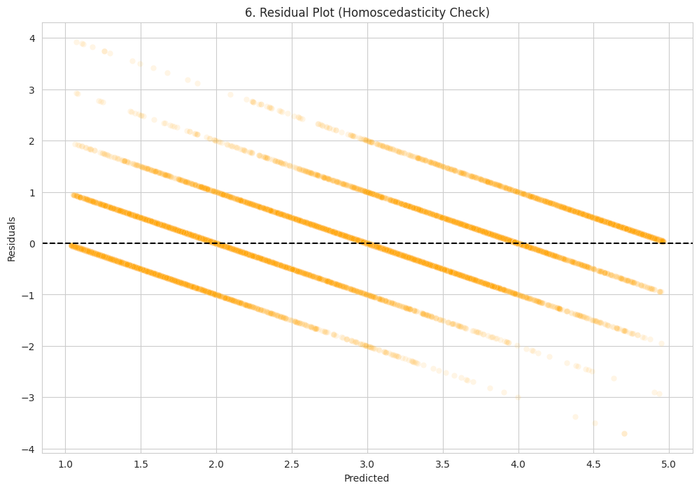
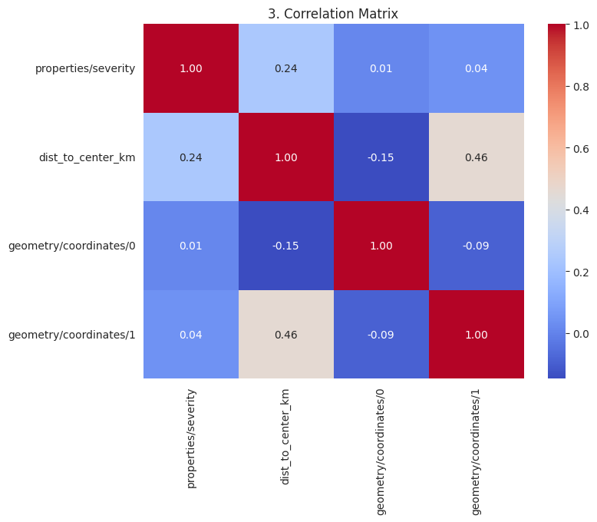
Appendix
A.1 Statistical Validation & Diagnostics
A.2 Initial Correlation Matrix
Residual Analysis: Errors are randomly distributed (Homoscedasticity), validating OLS assumptions.
Feature Selection: Lasso Regression successfully isolated key predictors.

Slide 26
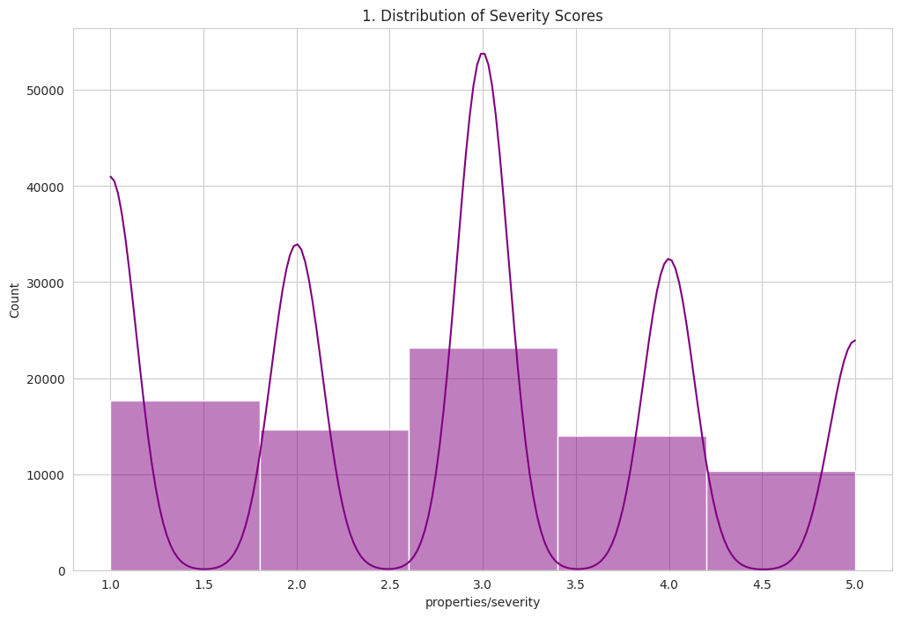
A.3 Plot 1 (Severity Distribution)

Slide 27
Thank You!
Willy Hung, Jayson Xu, Johnson Nguyen (Team Thinkers)

